Slide 1
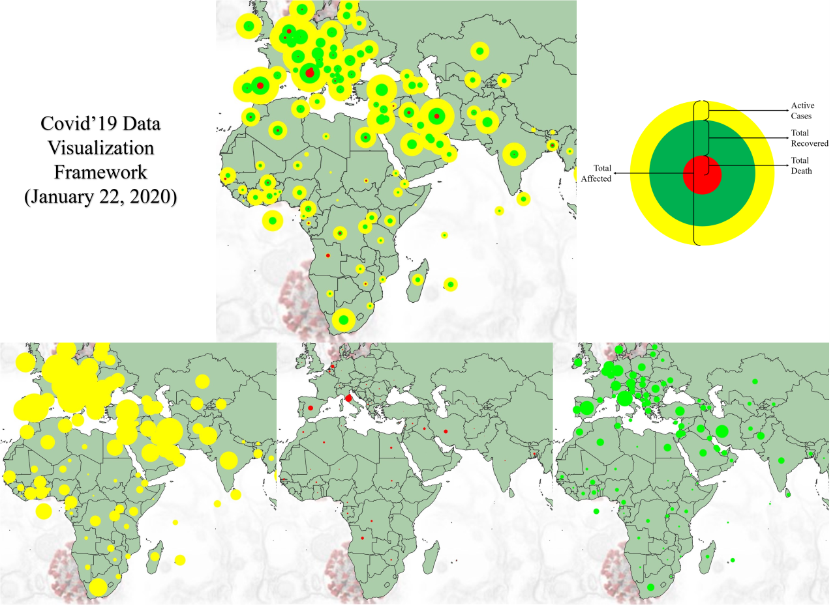
Before
Samiul Islam | CSI703

Slide 2
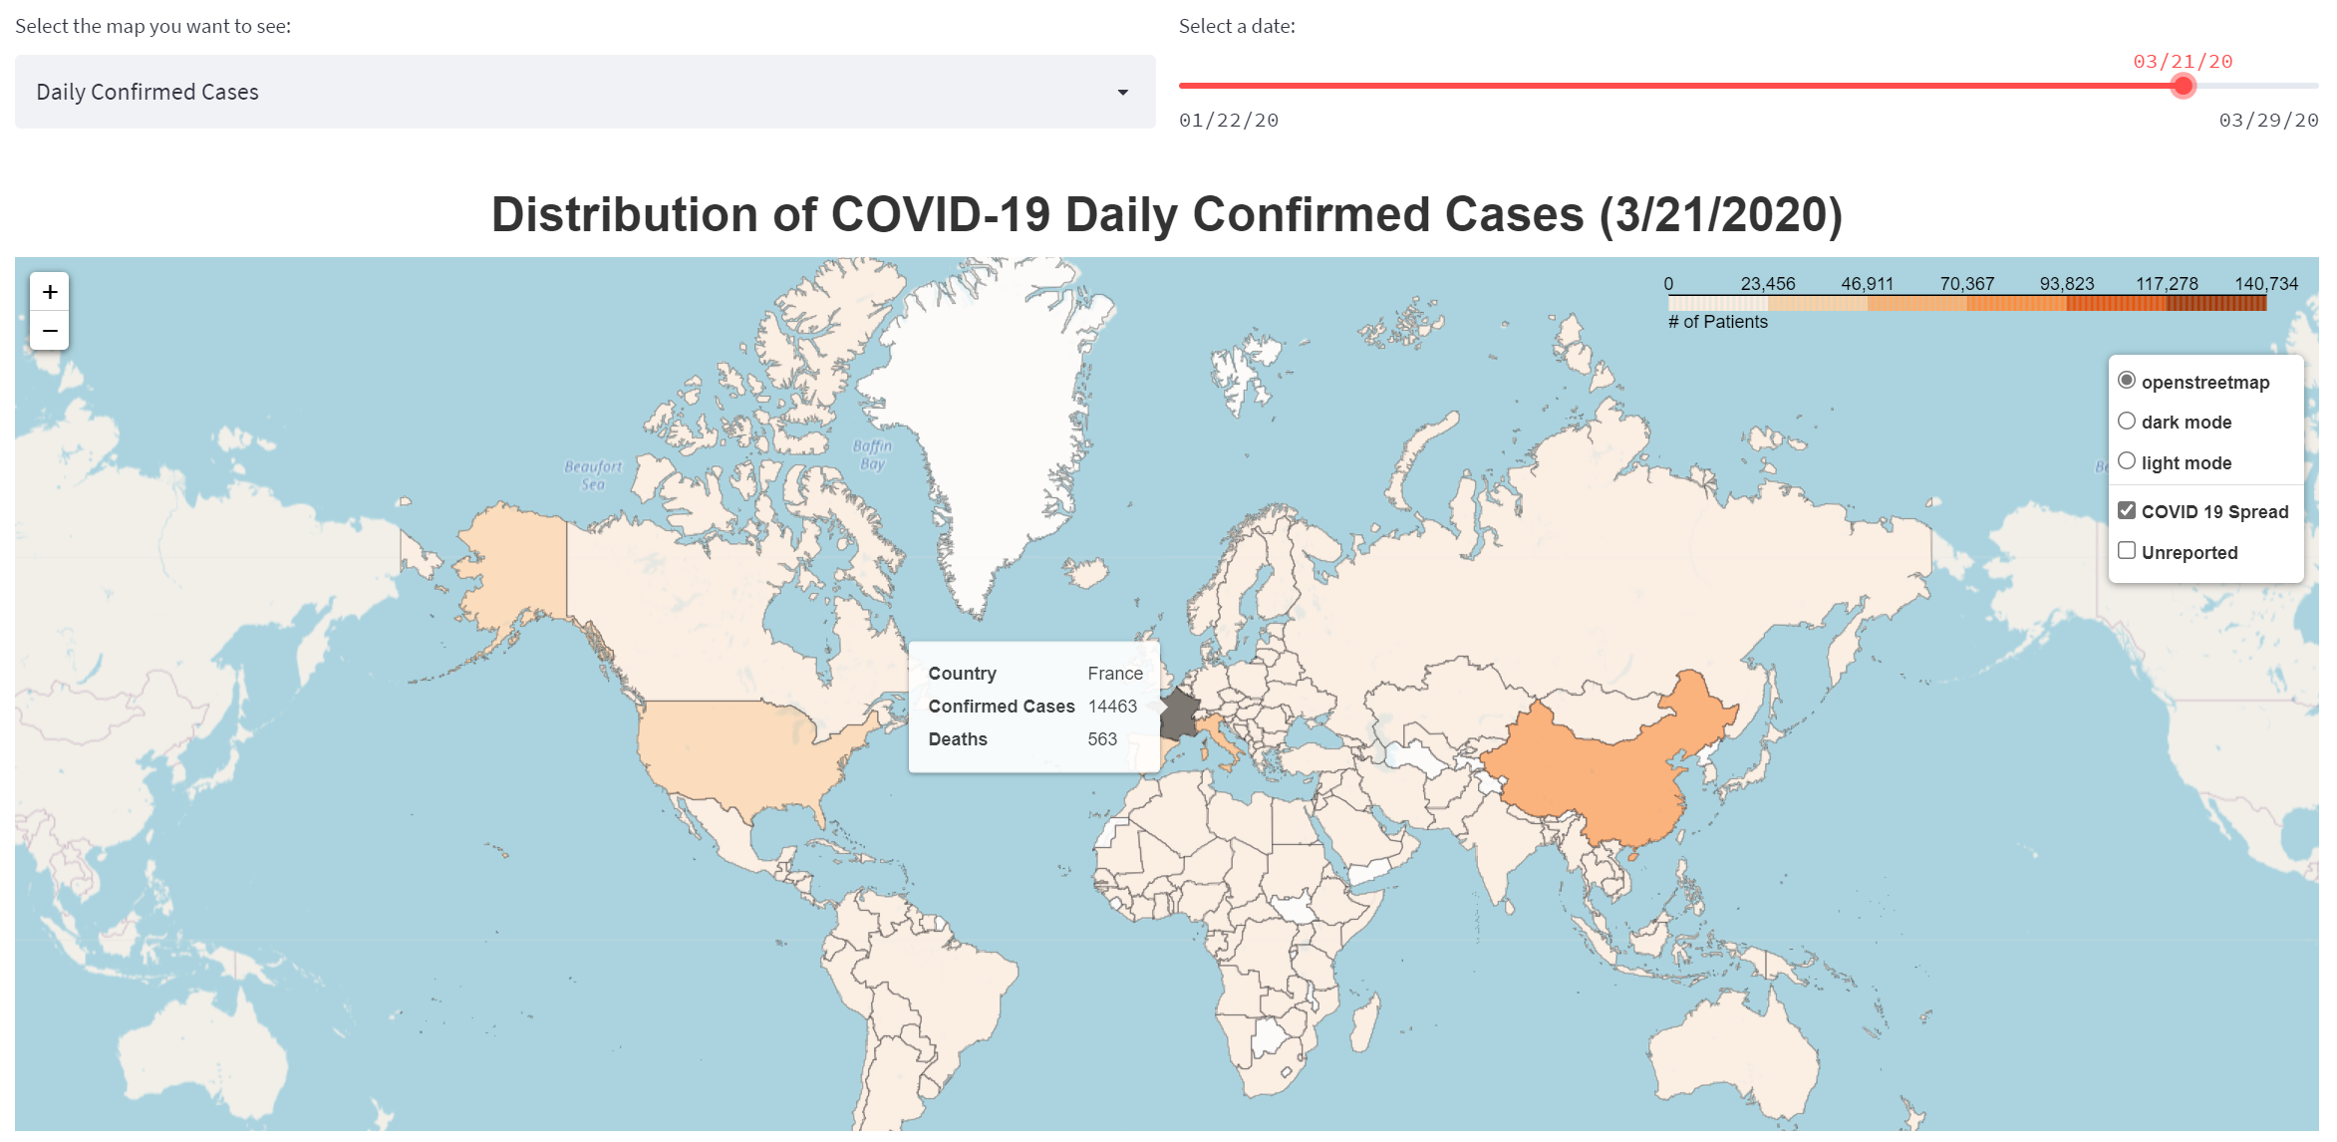

After
https://bit.ly/csi703_si
Developed using Streamlit
Samiul Islam | CSI703

